Slide 1
AI Driver in Baby Steps
Identifying Lane Lines
https://github.com/ericlavigne/CarND-Detect-Lane-Lines-And-Vehicles

Slide 2
Why an AI Driver?
Avoid 35k/yr traffic deaths in US and 1.2M/yr worldwide
Reclaim 24% of Los Angeles from parking spaces
Spend an hour per day reading instead of driving
Because it’s cool!

Slide 3
But AI is Hard…
How do we solve hard problems?
One step at a time

Slide 4
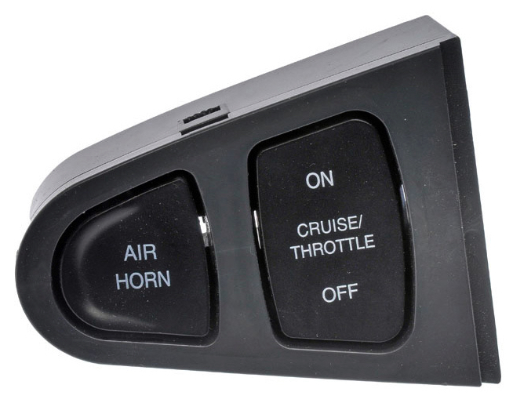
First Step: Cruise Control

Slide 5
Cruise Control
Human driver does the hard parts
Human driver turns on and off
Only used when helpful
What’s the next baby step?

Slide 6
Baby Steps
Cruise Control (Constant Speed)
Lane Keeping
Safe Following Distance
Recommending Path
Emergency Braking

Slide 7
Lane Keeping: Baby Step Has Baby Steps
Identify Lane Marking Pixels
Identify Lane Marking Positions
Curve Fit for Lane Lines
Calculate Car Distance from Center
Calculate Lane Curvature
Select Steering Angle

Slide 8
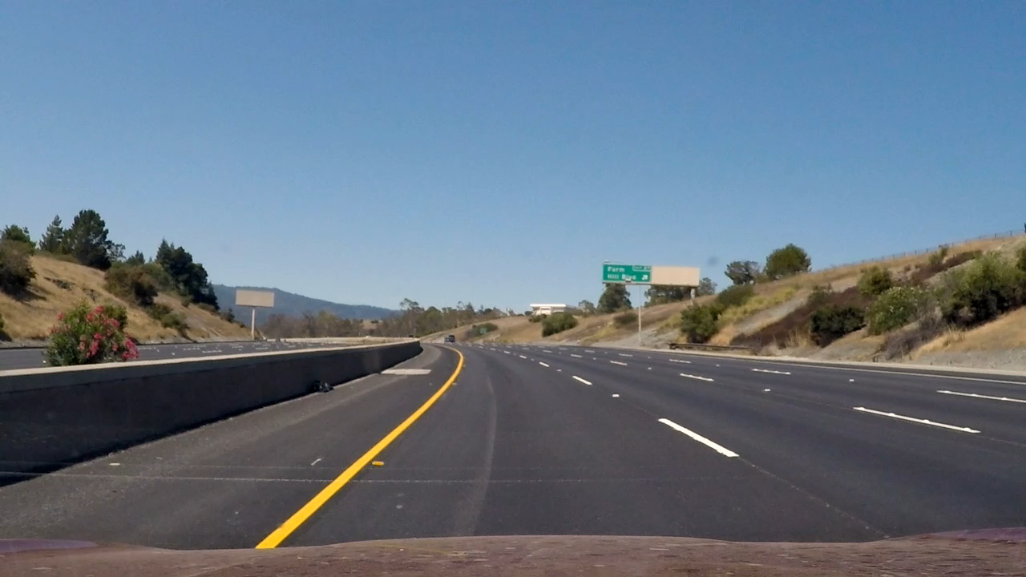
Input Video

Slide 9
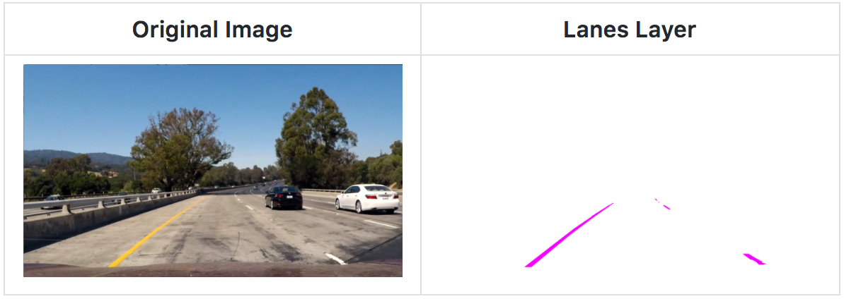
1. Identify Lane Marking Pixels

Slide 10
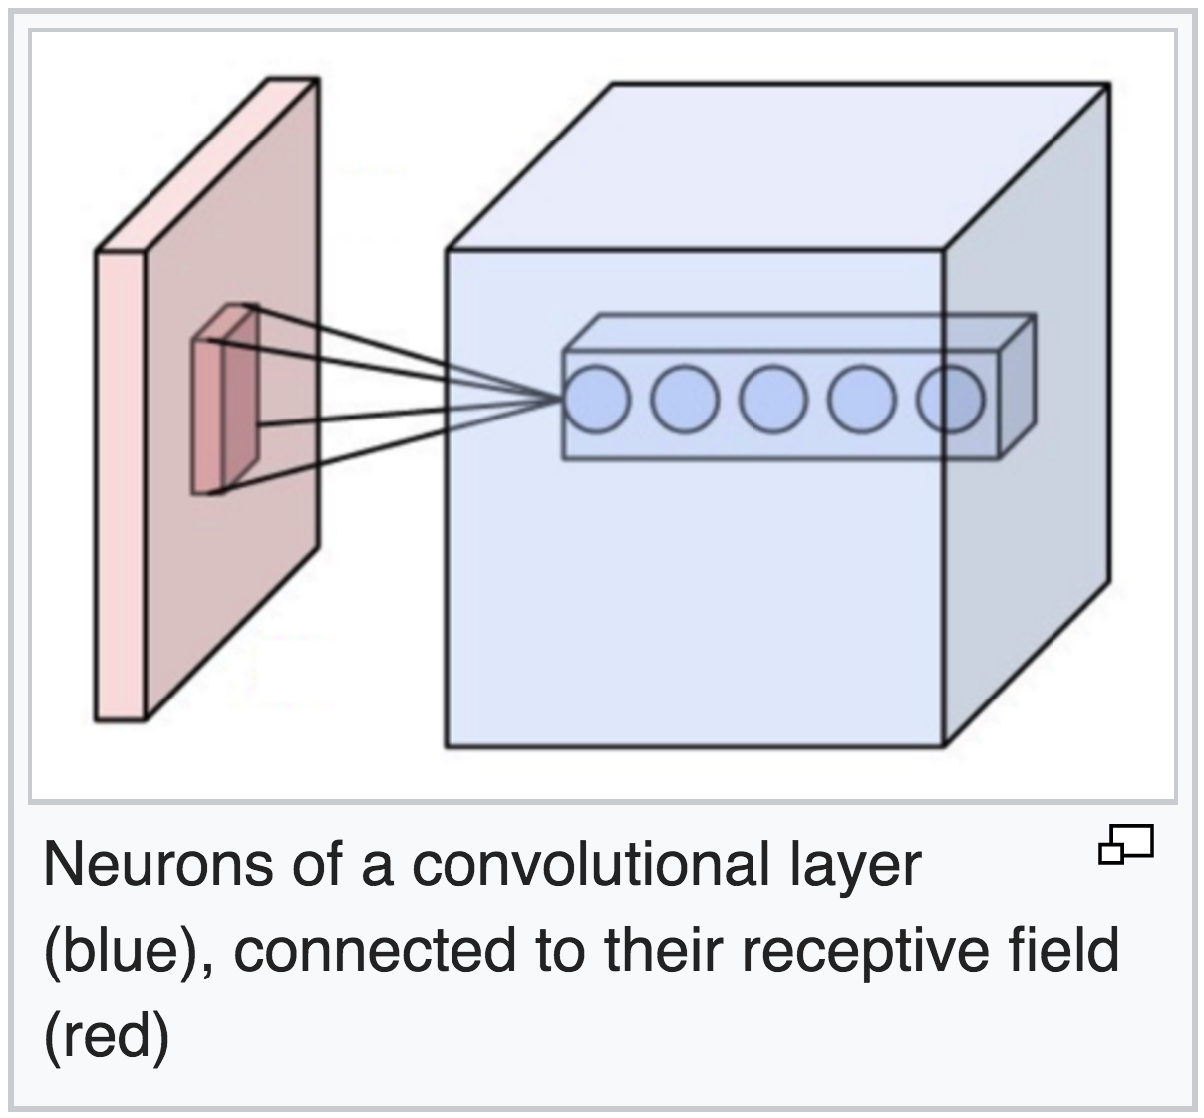
1. Identify Lane Marking Pixels

Slide 11
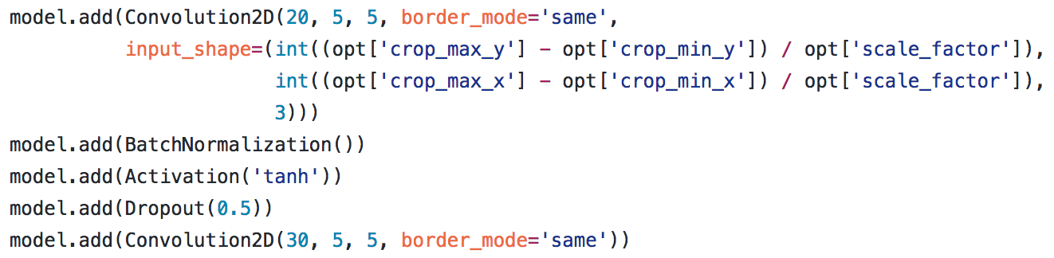
1. Identify Lane Marking Pixels
Layer Depths:
3 20 30 30 30 20 10 1

Slide 12
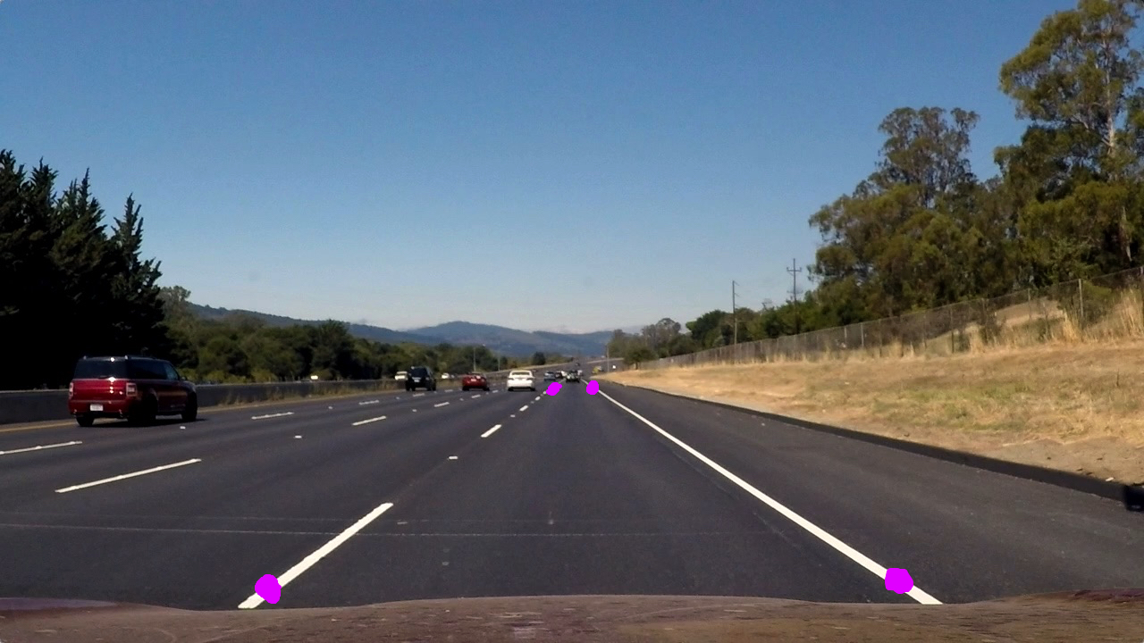
2. Identify Lane Marking Positions
M = cv2.getPerspectiveTransform(src,dst)
img = cv2.warpPerspective(img, M, (max_x, max_y))

Slide 13
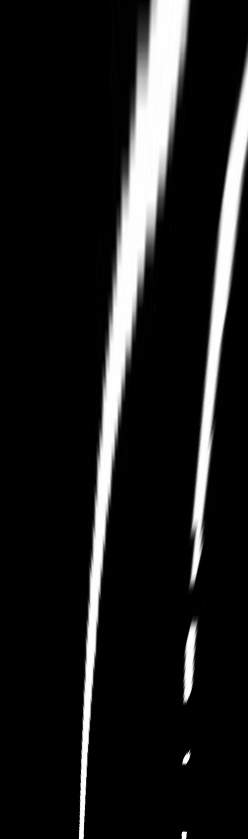
2. Identify Lane Marking Positions

Slide 14
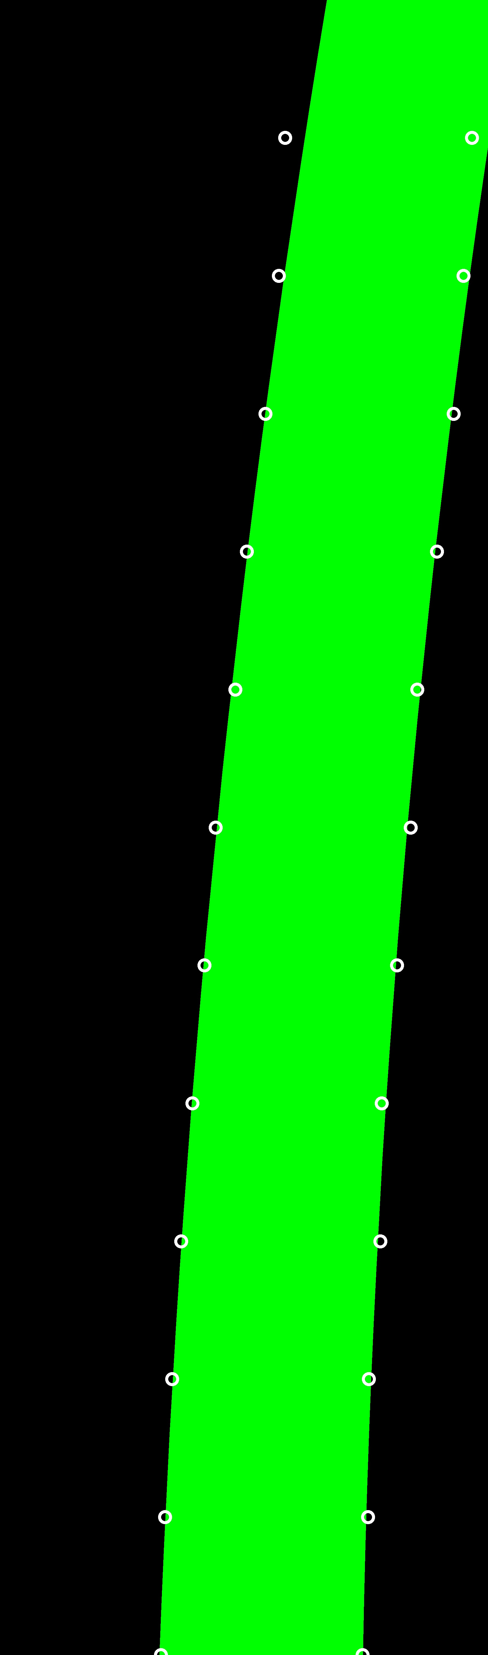
3. Curve Fit for Lane Lines
np.polyfit(y_vals, x_vals, 2)

Slide 15

4. Car Distance From Center

Slide 16
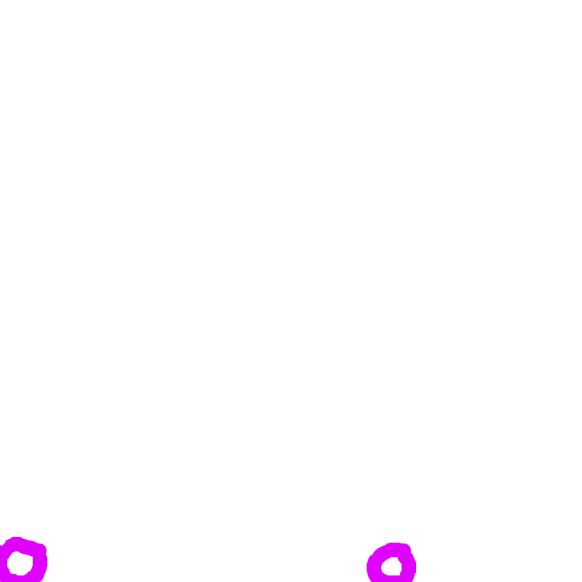
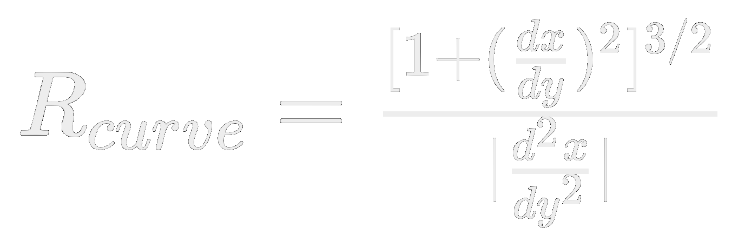
5. Lane Curvature

Slide 17
6. Steering Angle
Function of curvature, car distance from center, and car angle (assumed 0 degrees)
I didn’t do this part. Your turn. ;-)

Slide 18
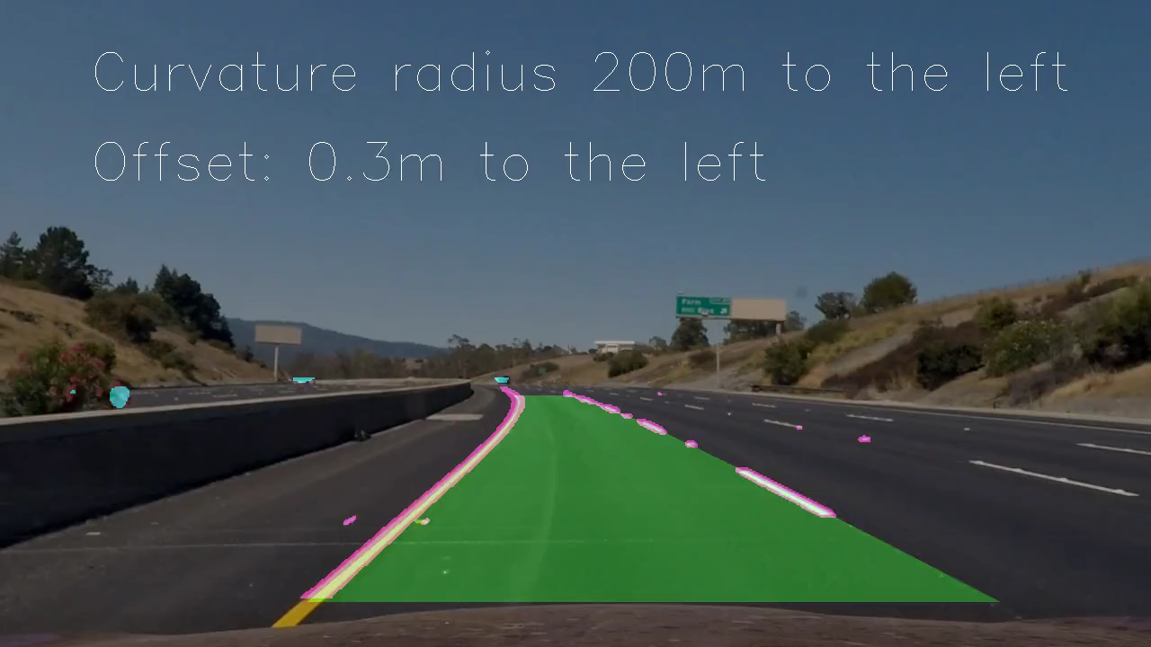
Final Result

Slide 19
Future Topics
Following a Lane (MPC)
Optimizing Car Detection (Lyft Perception Challenge)
Passing Other Cars (A*)
Urban Driving (CARLA)

Slide 20
Get the Code!
https://github.com/ericlavigne/CarND-Detect-Lane-Lines-And-Vehicles
Any Questions?

